Slide 1


HPC Analyses with Code Versioning
How to combine Rivanna and Github
for better data science neuroscience
Mark J. Lawson, PhD
Senior Biostatistician
Department of Neuroscience
Center for Brain, Immunology, and Glia (BIG)

Slide 2
Goals
Understand the why and how of using a code versioning system like git / Github
Know how to get started with your project on UVA’s high performance cluster Rivanna using a Unix terminal
How to submit a job that requires high performance to Rivanna using slurm

Slide 3


Three main technologies
git
Unix
slurm

Slide 4
git is a way to store and version control your code
“A system that tracks every change to your files over time, like an unlimited undo button with a complete history”
Provides an interface for who made the changes and why they were made
Allows for easy collaboration between a team of researchers
Can roll back to a previous version as they are all preserved
Can ensure reproducibility of an analysis
A central repository (Github, Gitlab) that can be shared amongst team members and external collaborators
Even for just an individual to share between different computers …
git is meant for code and NOT data

Slide 5
How do I get git?
If you have a Mac, it should be pre-installed
If it is not pre-installed, make sure you have the “Xcode command line tools” installed
If you have a Windows machine, you need to install it
https://gitforwindows.org/

Slide 6

Commonly used git commands
git init/clone
Create a new git repository (init) or download a repository (clone)
git add
Add a new file to be tracked by git version control
git commit
Save changes to the file and a comment about the change to the repository
git push
Save all commits to the repository to an external location
git pull
Download all changes to the repository to your local version
git fork
Create a copy of a different repository to make your own modifications

Slide 7
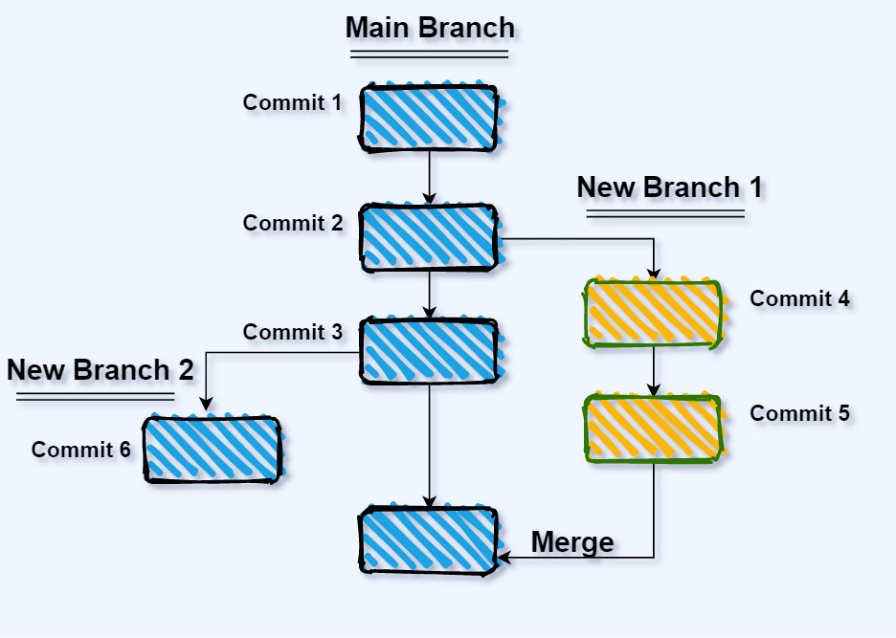
More advanced git commands
git branch
Create a branch in the code, so crazy new ideas can be experimented with
Main branch of the code is unaffected, just in case those crazy new ideas end up breaking things
git merge
Hey, looks like that crazy new idea does work! Let’s merge it back in with the main branch
git automates merging in the changes (and typically does a good job) but might require hand-holding if changes are complex

Slide 8
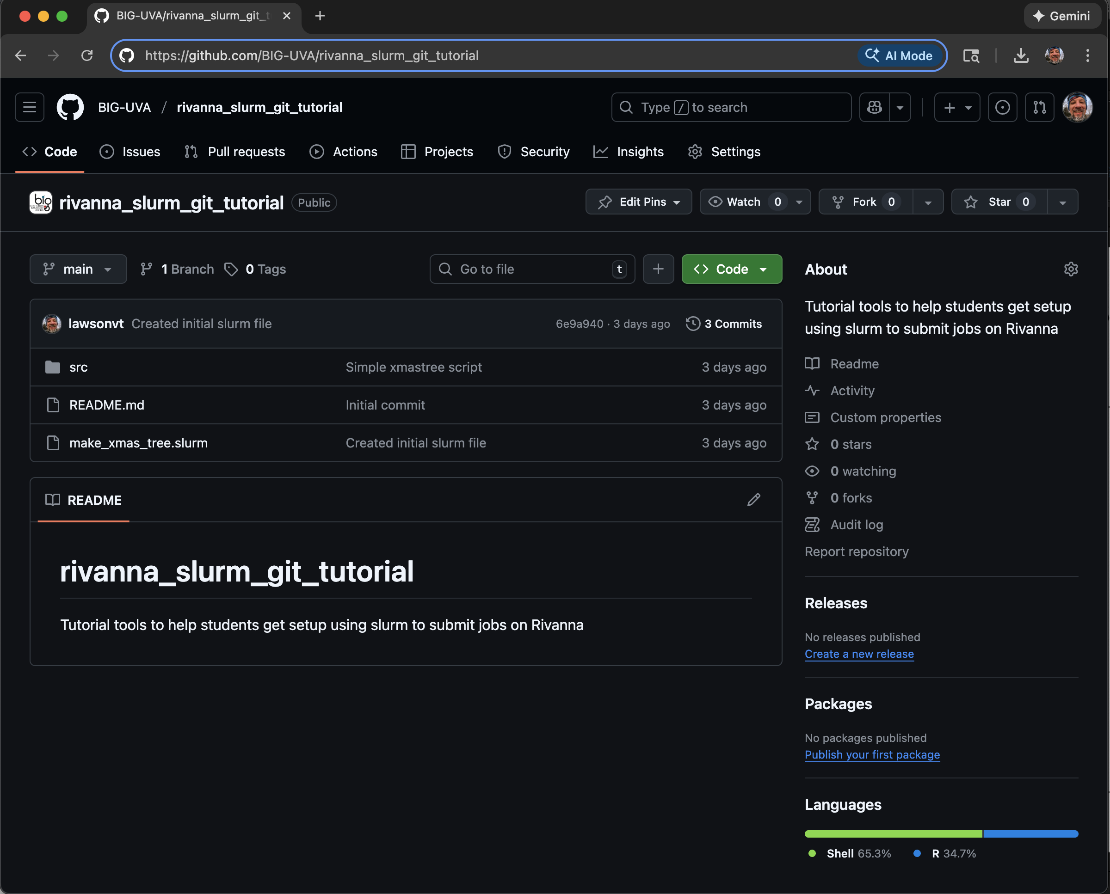
Github is online storage to store and share code using git
An online storage space that serves as the hub for your code
Free to join, free to store code
Especially if you are publicly sharing your code
Private code has restrictions and might require payment
User controls who can make changes to code

Slide 9
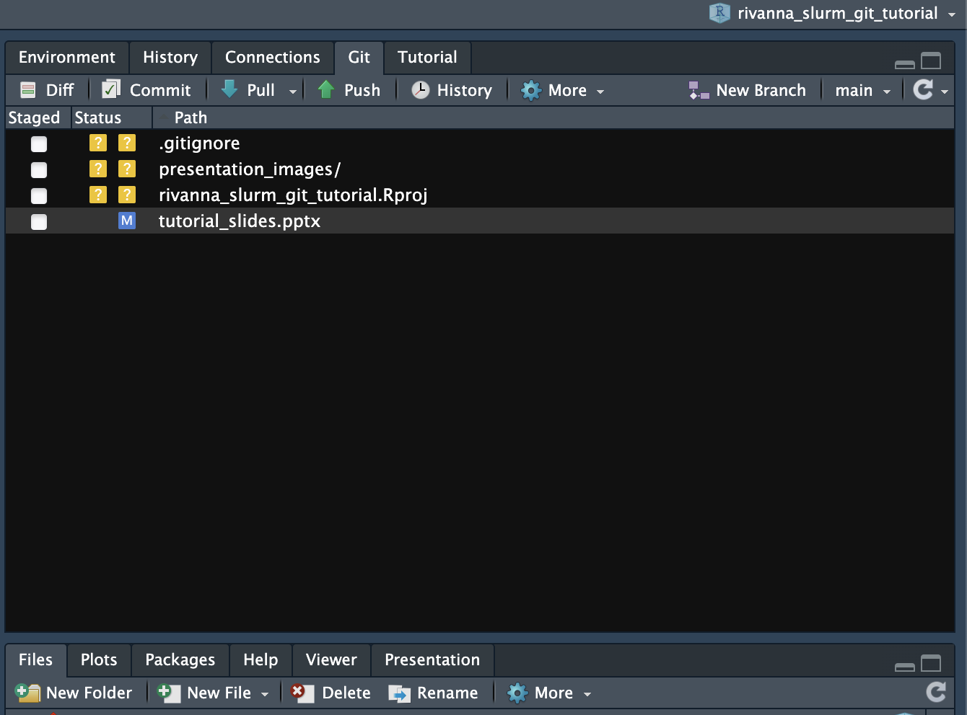
git / Github integrates well with RStudio
Initializing a project with git in Rstudio creates the git control panel
This panel gives you controls for all commonly used git commands
Visual overview of files and untracked changes
No command line needed!

Slide 10
Tutorial Part 1
If you don’t have a Github account, create one
Go to the Github repository https://github.com/BIG-UVA/rivanna_slurm_git_tutorial
Fork the repository into your personal repositories
Start a new project in Rstudio, pointing towards your forked repository

Slide 11
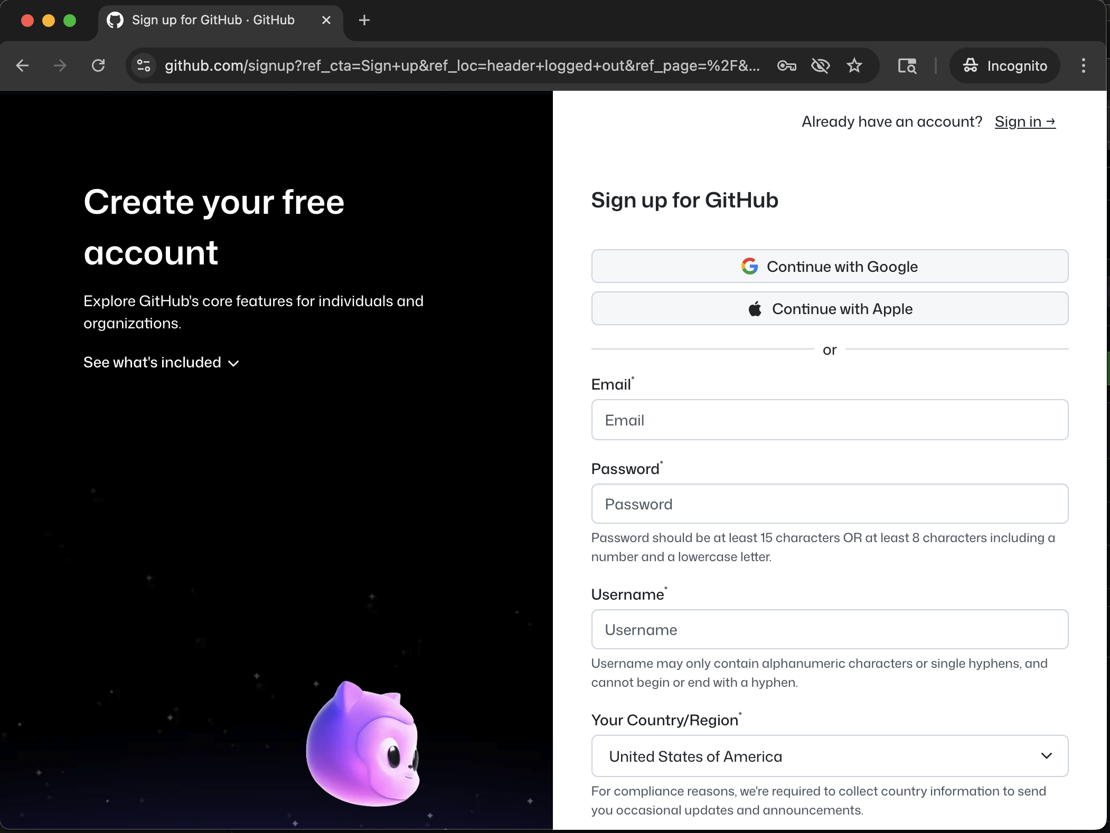
Create a Github account
In order to be able to create repositories, you need a Github account
Requires you to pick a username
Due to collaboration and potential future employment, make sure to pick one that is SFW

Slide 12
Login and fork the tutorial Github repo
https://github.com/BIG-UVA/rivanna_slurm_git_tutorial
Click this

Slide 13
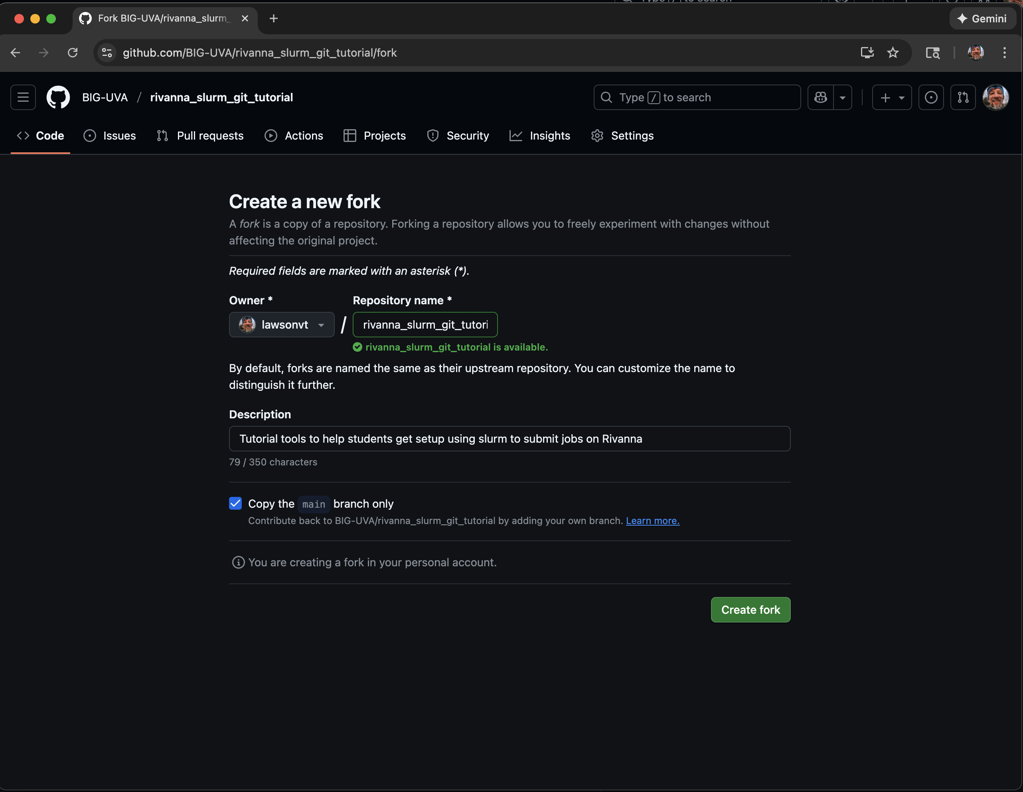
Create the fork in your personal space
Can change the name of the repository
Click here to create the fork

Slide 14
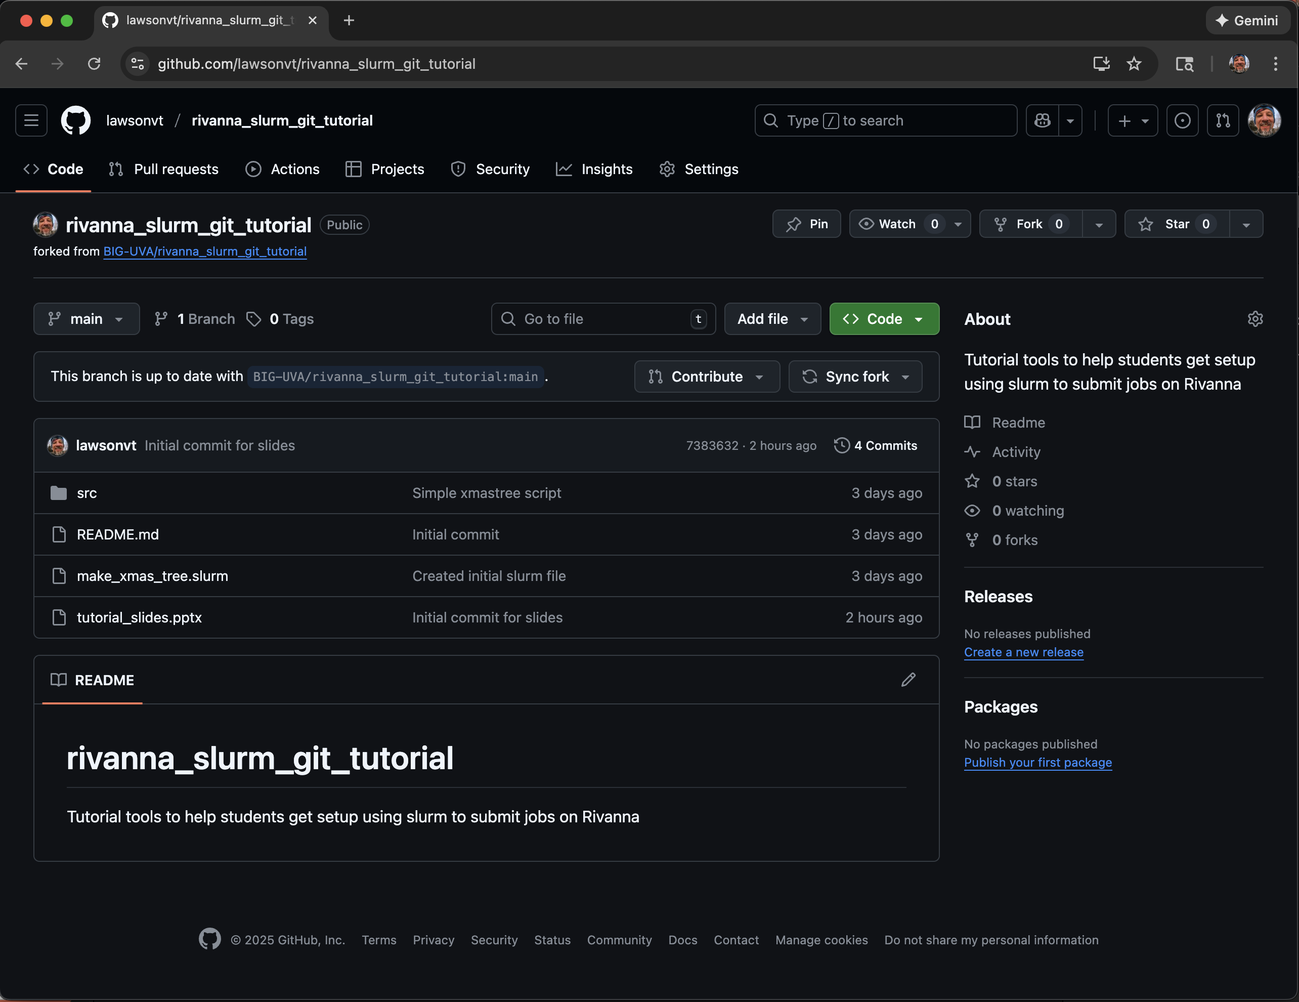
A forked version now exists in your personal repos
Shows the current owner as well as providing a link to the original repo
Otherwise looks the same as the original repo

Slide 15
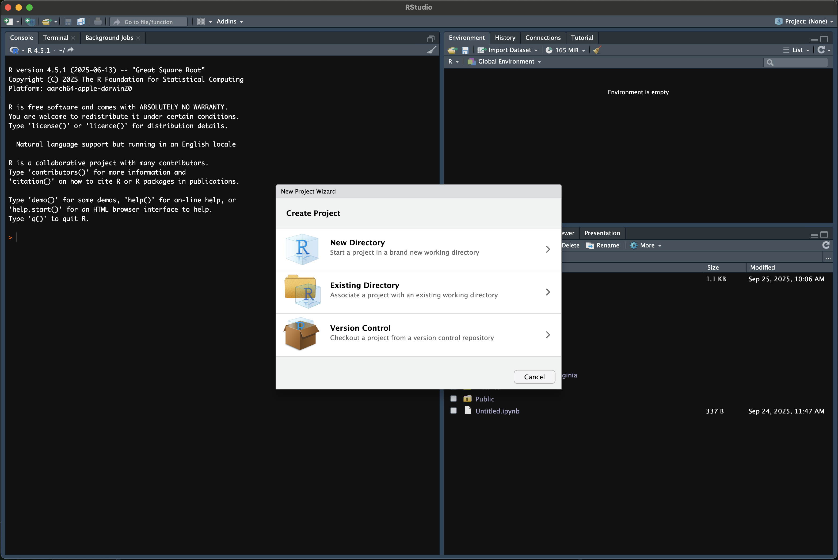
Create a new project in Rstudio
Select Version Control and select “git” in the next menu

Slide 16
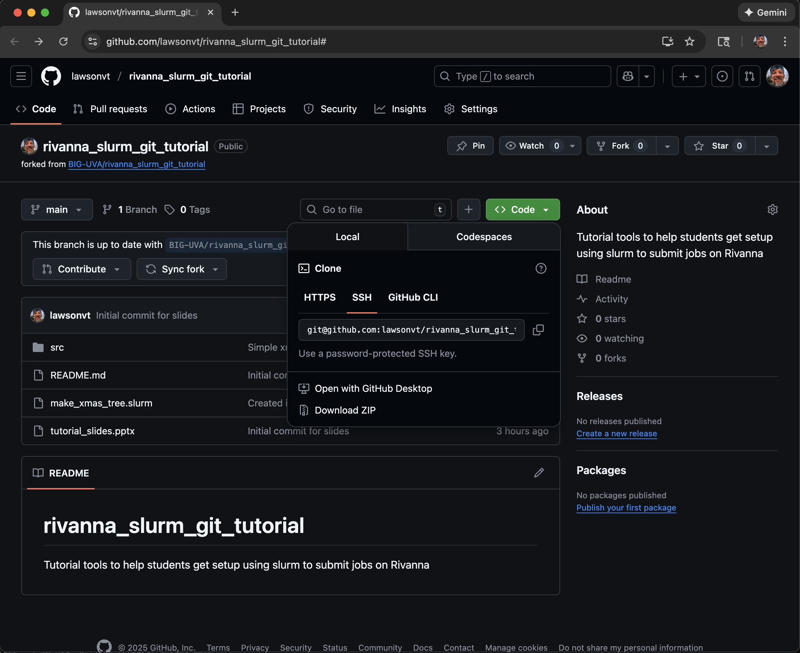
Clone the repo
Select Code
Copy the URL

Slide 17
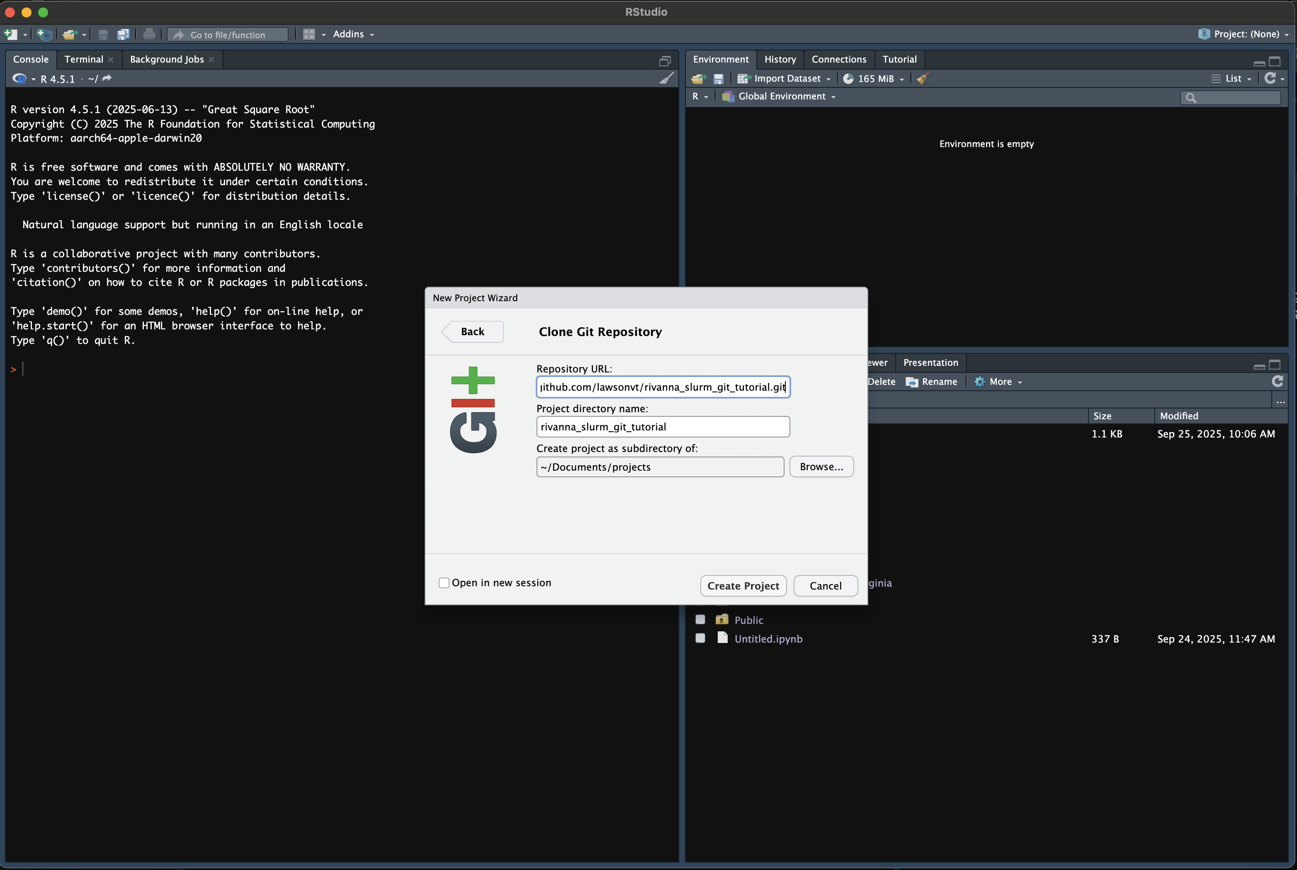
Create a new project in Rstudio
Paste the URL
Select the local location for storing the project

Slide 18
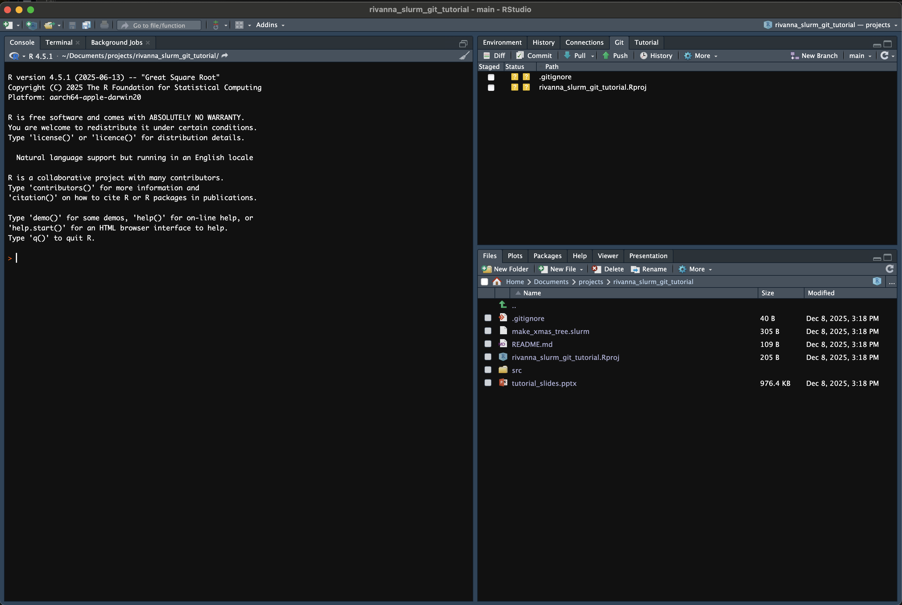
Create a new project in Rstudio

Slide 19
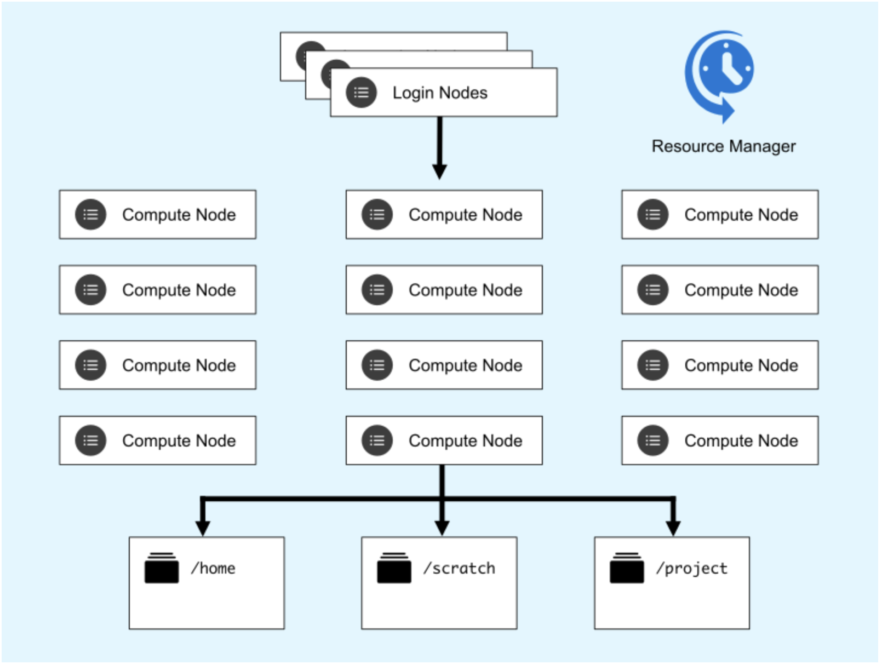
Rivanna – UVA’s High Performance Computing Environment
UVA Resarch Computing provides access to various HPC environments, of which Rivanna is one
Basically, this gives the researcher the ability to run jobs that would be beyond their laptop
In terms of memory, processors, computing time
To do this, a researcher logs into Rivanna and submits jobs to the cluster
The next parts will go over how this works …

Slide 20
Unix – under the hood of what you are using
Designed as one of the first multi-user operating systems, it is underneath most operating systems in-use today
Linux, Android, iOS/OSX are all Unix-based systems
Windows is NOT
It is a commonly used interface for cloud computing, so some basic knowledge about how it works is very worthwhile to learn
The Rivanna login nodes use Rocky Linux but the basic commands covered here will work for any version of Unix

Slide 21
Simple Unix commands
pwd
Lists your current location or present working directory
ls
Lists the contents of the directory
ls –lh
List the contents in a list format with human readable file sizes
cd <directory>
Change to the given directory
cd ..
Exit the current directory; go one level up
less <file>
Read the given file in the terminal
cat <file>
Have contents of file returned to the command line
ssh <user_id>@<ip_address>
Use secure shell to connect to a remote computer
mkdir <new_directory>
Make a new directory
cp <file> <new_file>
Make a copy of the given file to with new given file name
cp -r <folder> <new_folder>
Make a copy of the given folder to the new given folder name (using recursion)
rm <file>
Delete (or remove) the given file
warning: this is permanent!
rm –r <folder>
Delete the given folder (using recursion)
exit
Exit the session (for instance disconnect ssh)

Slide 22
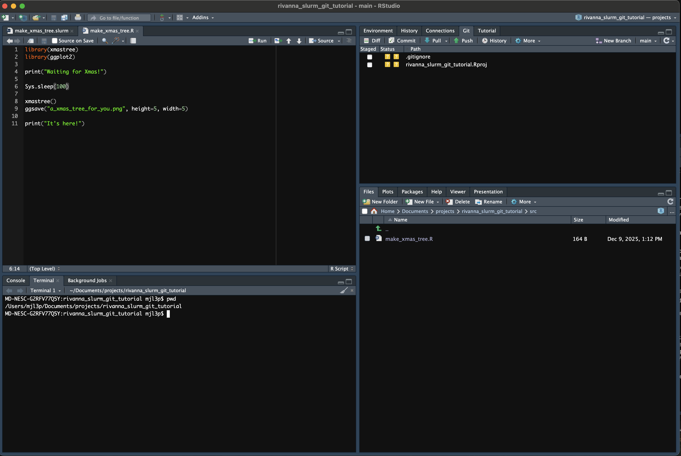
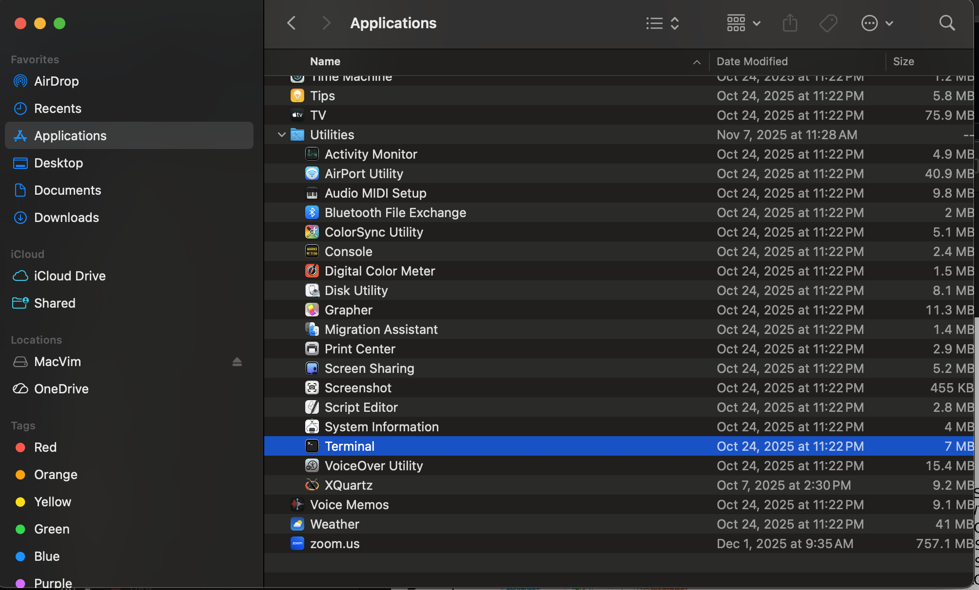
Unix on your computer (if you have a Mac)
Open the Terminal app
Use the Terminal tab in Rstudio

Slide 23
Tutorial Part 2
Use an SSH key with Github
Login to Rivanna
git clone the repository into Rivanna
Move into the cloned repo
Make a change to the code on Rstudio
Commit and push change
git pull the change

Slide 24
Creating an SSH Key
While you can clone any public Github repo, in order for you to create new commits to the repo, you need to be authenticated
There are many ways to do this, but the easiest is to use SSH Keys
Open a Terminal and create a key using this command
ssh-keygen -t ed25519 -C "your_email@example.com"
Make sure the email address is the same one you used to create your github account
Feel free to skip creating a password, otherwise you will need to use it for every commit
For Windows users, use the “Git Bash” app
Then copy the key to the clipboard
cat ~/.ssh/id_ed25519.pub | pbcopy

Slide 25
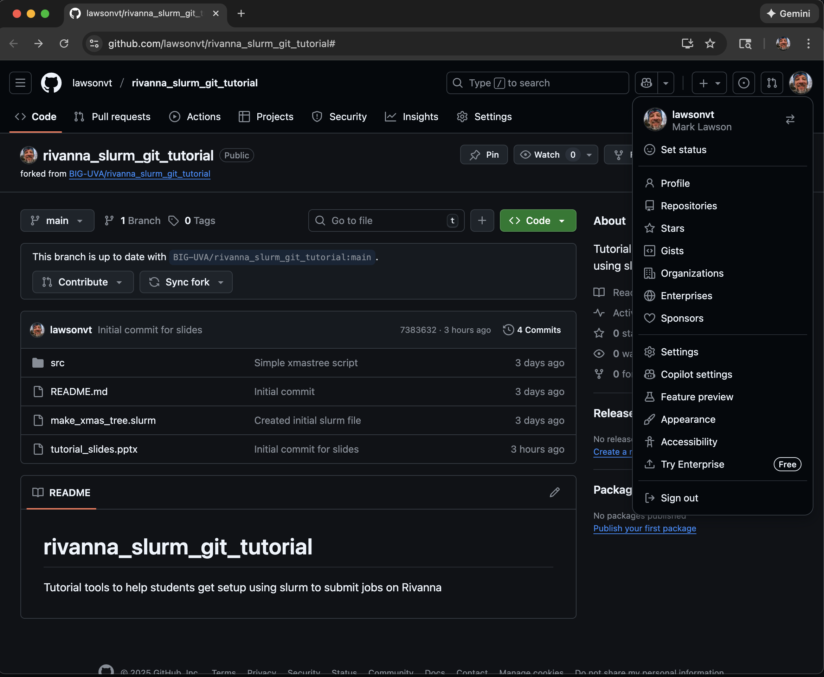
Adding the SSH key to Github
Click profile image to view options
Select Settings

Slide 26
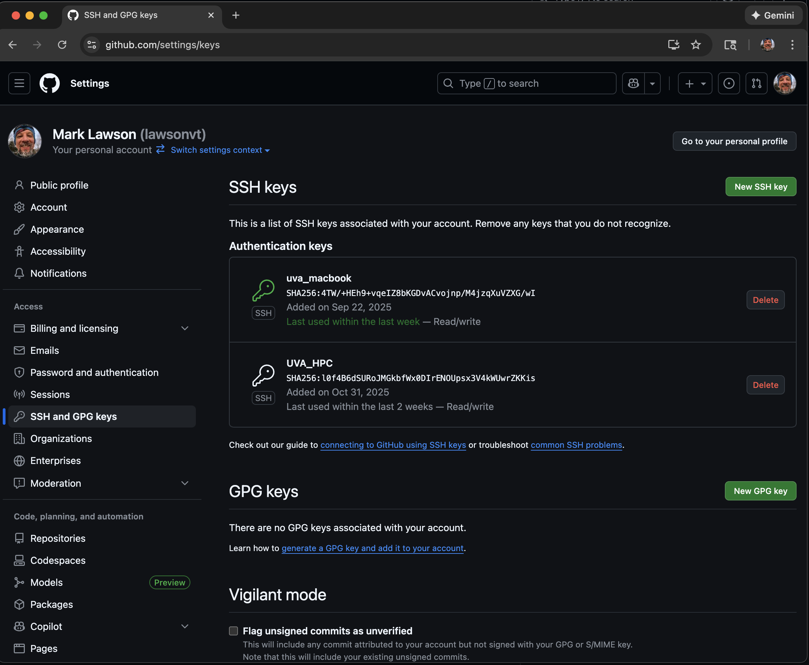
Adding the SSH key to Github
Select this to upload new SSH key
Click here

Slide 27
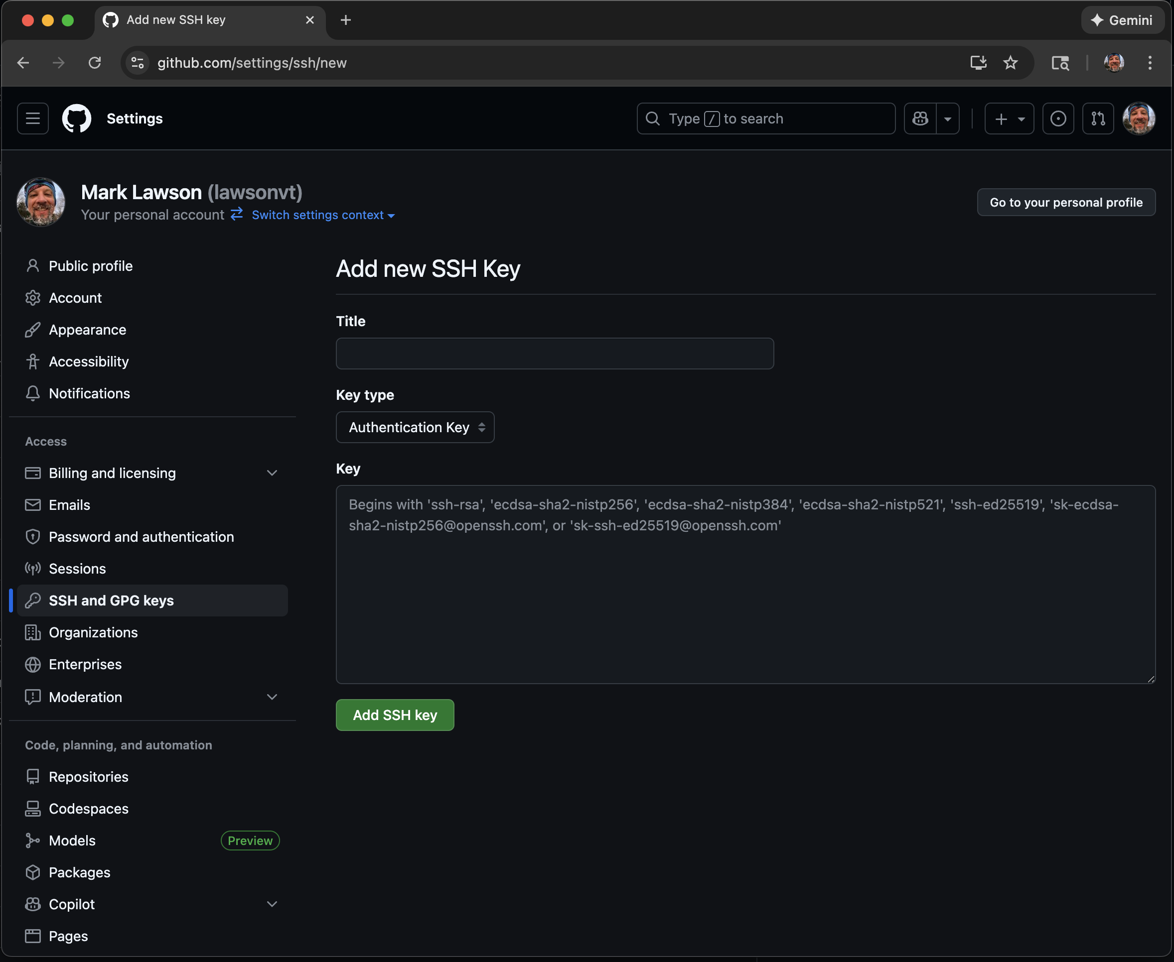
Adding the SSH key to Github
Give your key a name.
Maybe something that indicates the computer it’s from
Paste your key here

Slide 28
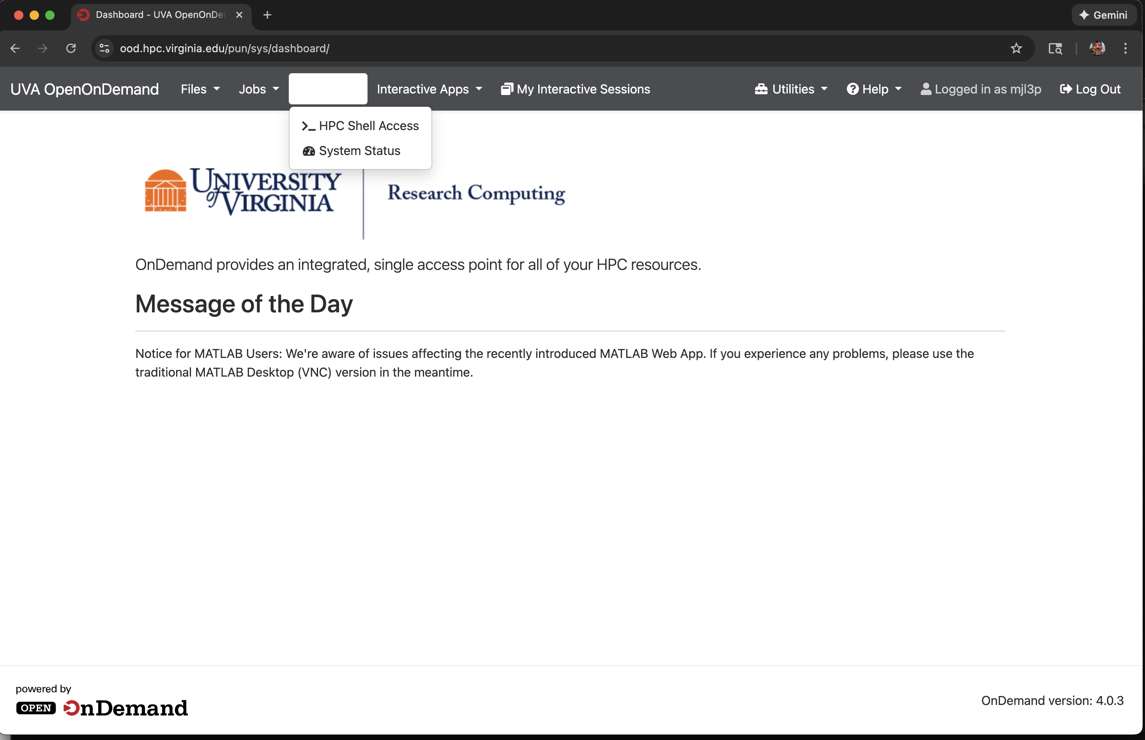
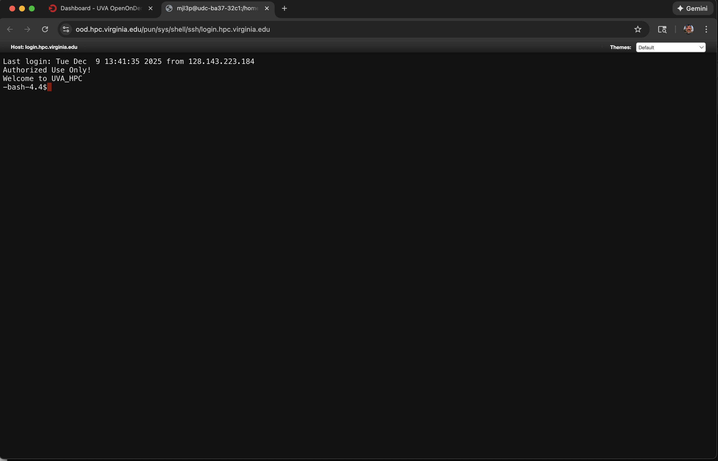
Logging into Rivanna – Option 1
Open On Demand https://ood.hpc.virginia.edu/
Select Clusters
Select HPC Shell Access

Slide 29
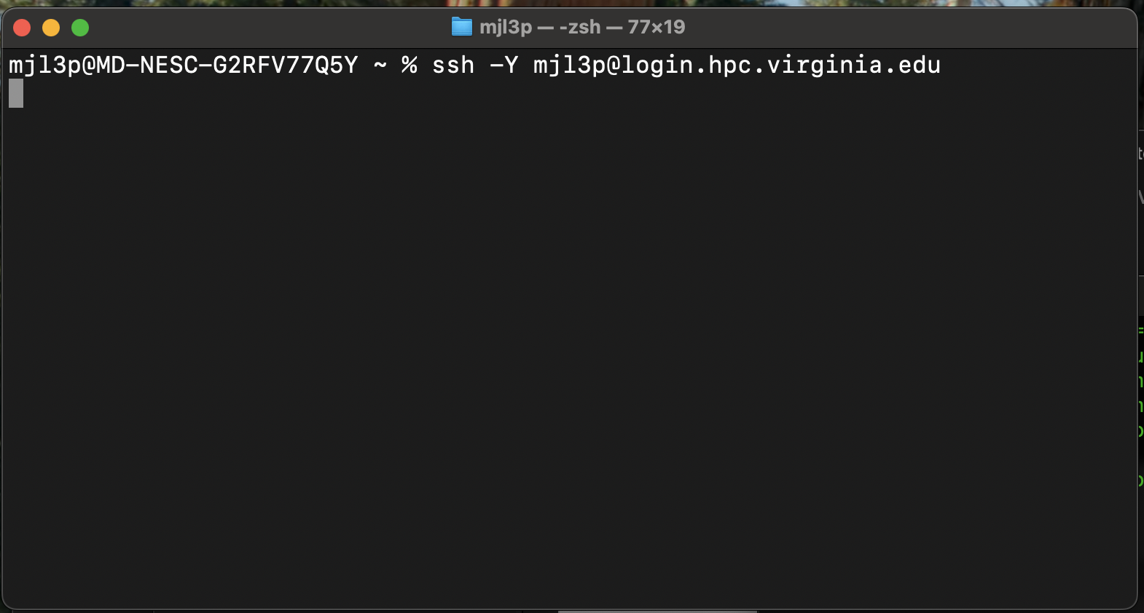
Logging into Rivanna – Option 2
Use secure shell (SSH) in a Terminal:
ssh –Y <your_user_id>@login.hpc.virginia.edu

Slide 30
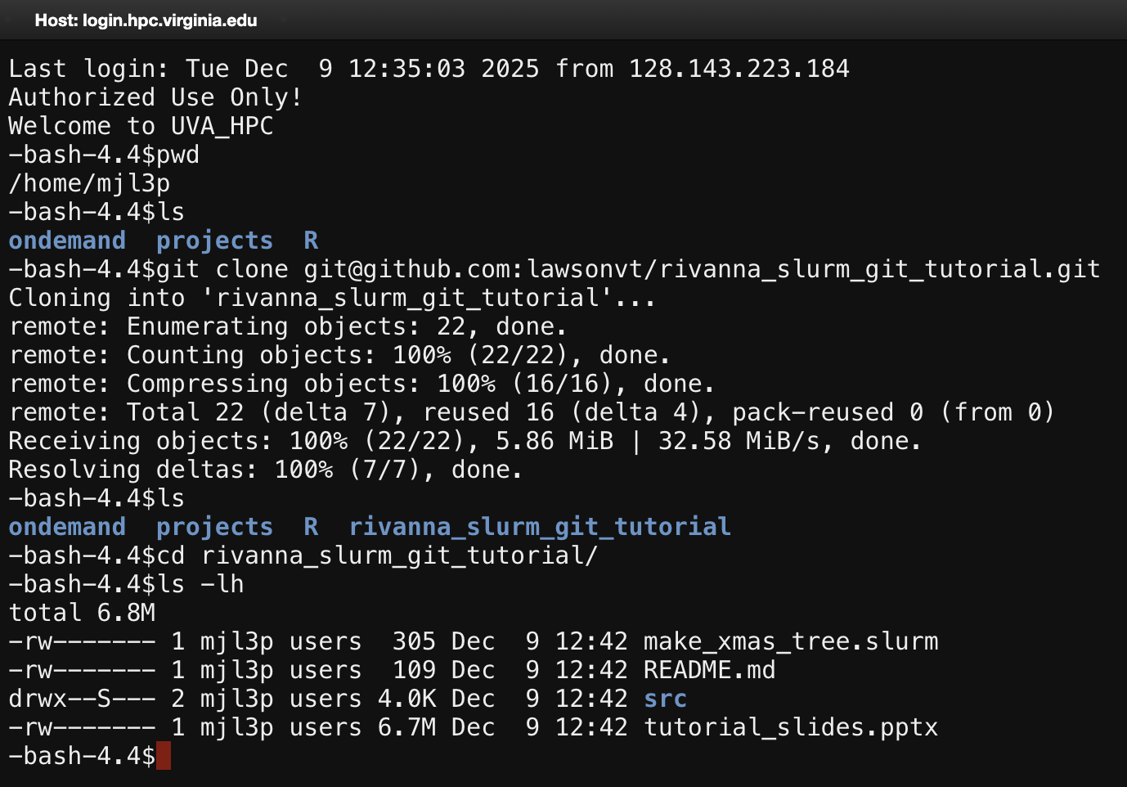
Unix Command Line
Where are we
Clone repository into your home directory
What is here
Move into directory and see what is there

Slide 31
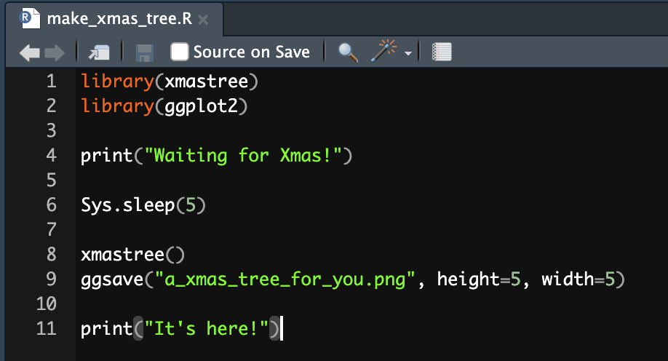
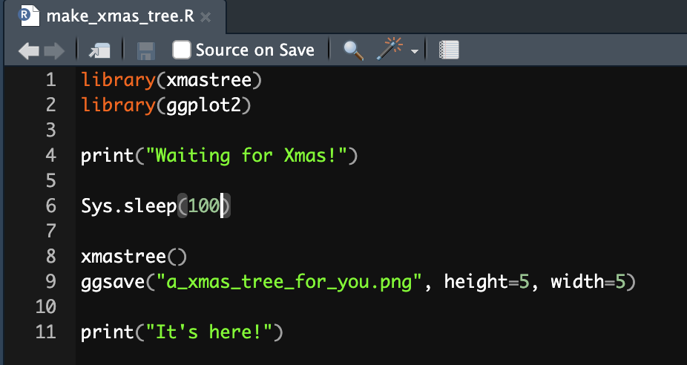
Let’s make a change!
In your local version of Rstudio, open the R file and change a line of code

Slide 32
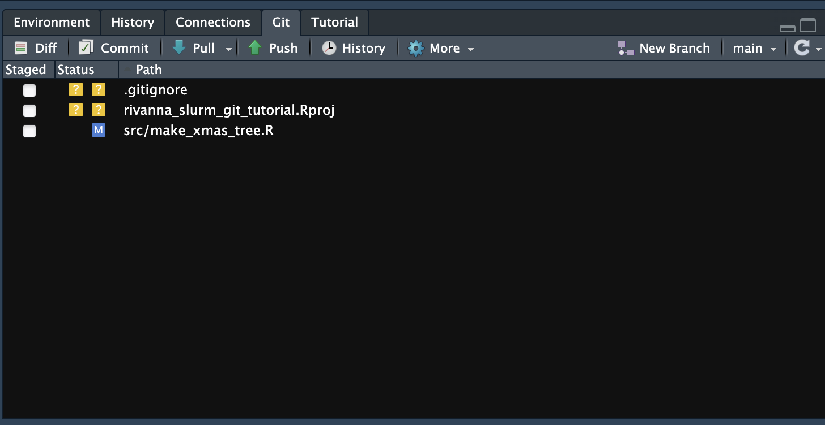
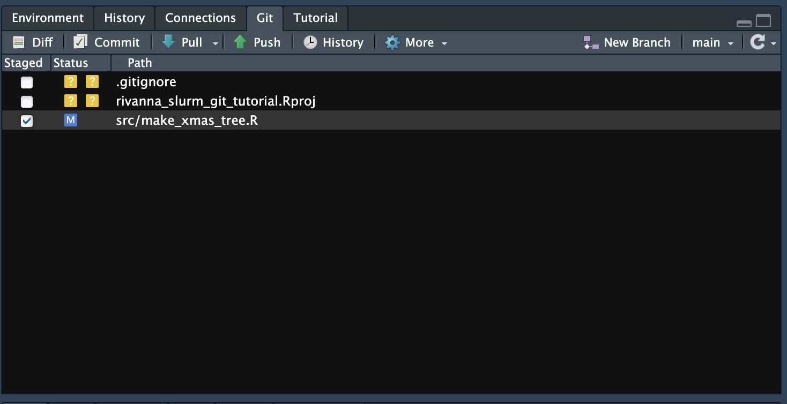
Start the commit!
In Rstudio, open the Git section and “stage” the changed file
Select Commit

Slide 33
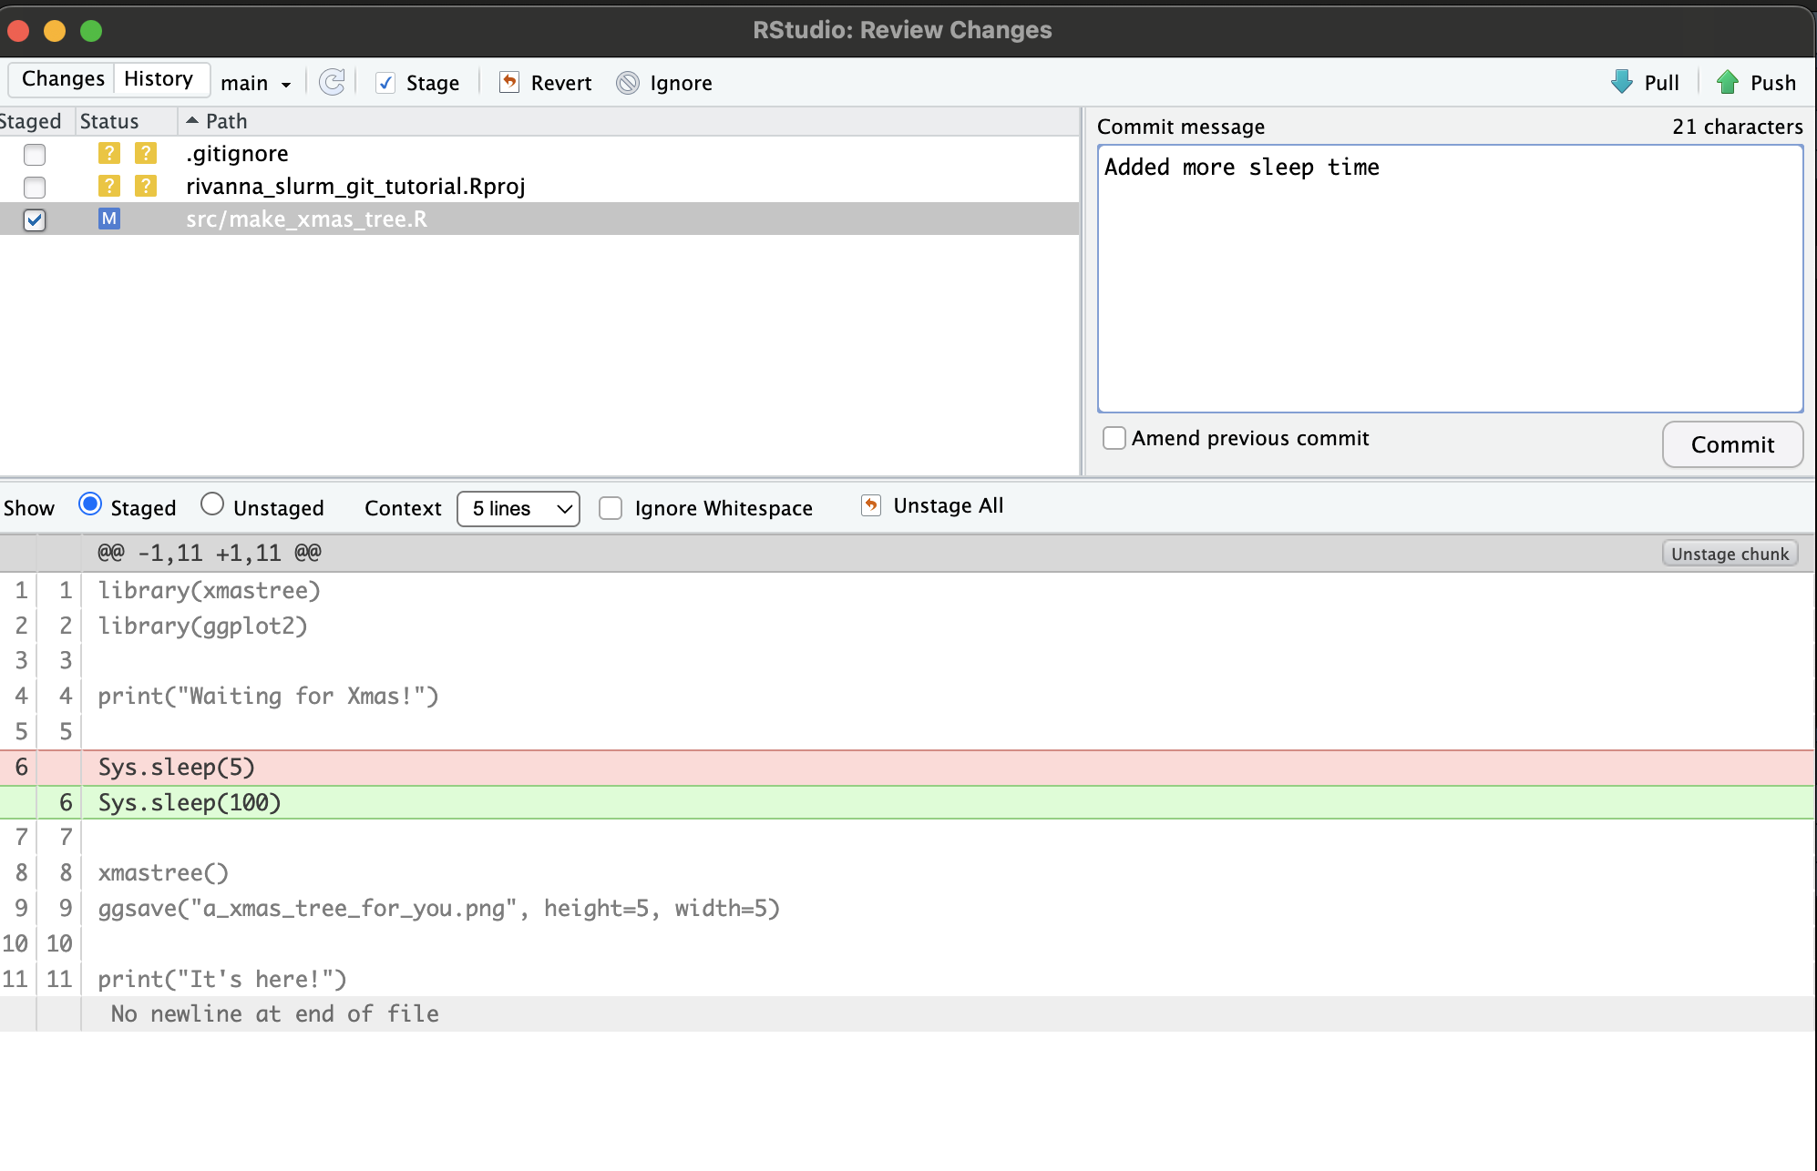
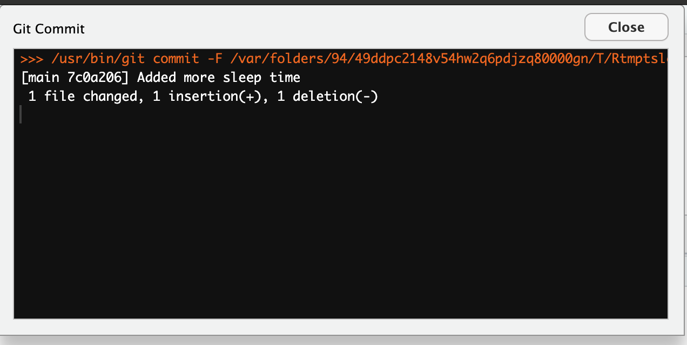
Commit the change!
After adding a commit message (required), select the commit button

Slide 34
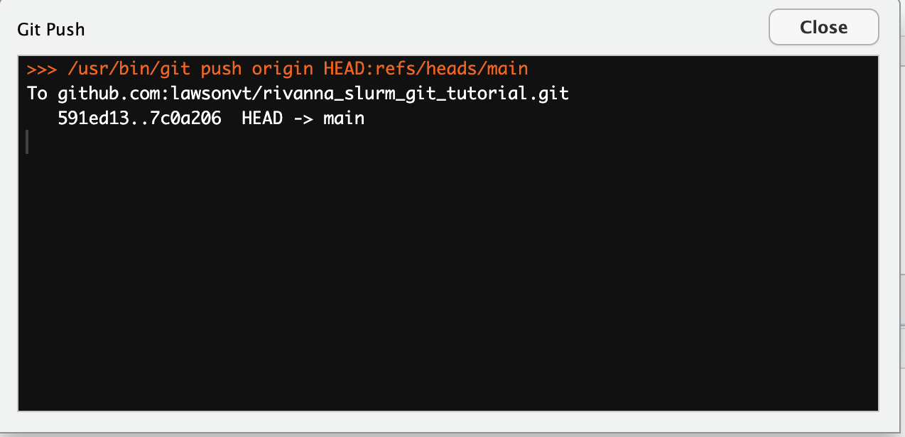
Push the change!
After committing, select the Push button

Slide 35
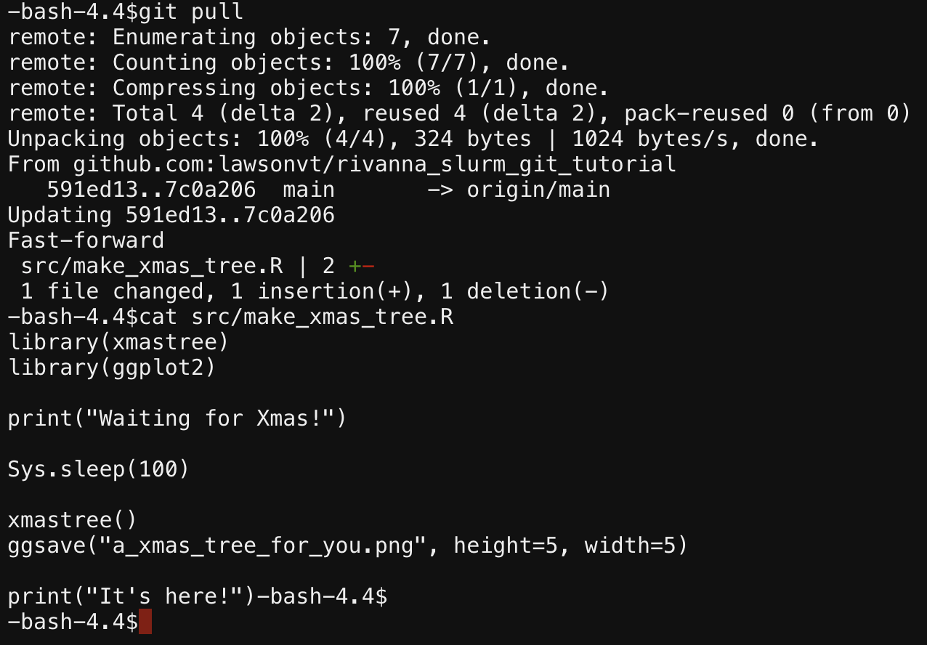
Pull the change (on Rivanna)!
Pull in the change
Check that the file has changed

Slide 36
Tutorial Part 3
Submit job with slurm
Job had error, read file to see why
Load R and install missing package
Submit job again
Monitor job in the queue
Check results

Slide 37

What is slurm
slurm manages the execution of your big jobs on an HPC network
Jobs are submitted to the slurm controller, which queues them until the system is ready to run them.
The controller selects which jobs to run, when to run them, and how to place them on the compute node or nodes, according to a predetermined site policy meant to balance competing user needs and to maximize efficient use of cluster resources.

Slide 38
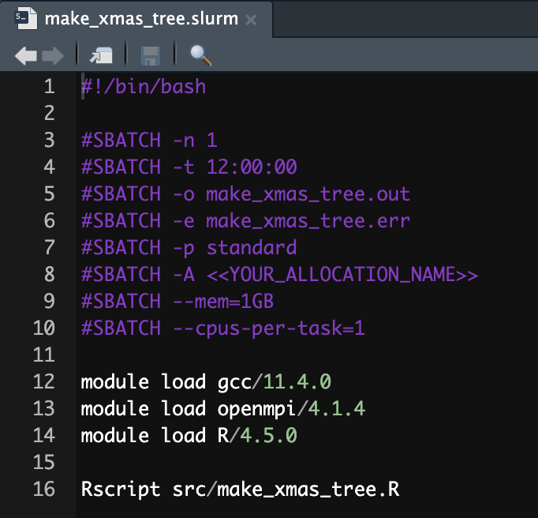
The slurm batch file
Number of nodes needed (has to be 1)
Total time needed for execution
Define output and error files
List your allocation
How much memory and CPUs are needed
Load R
Run the script!

Slide 39
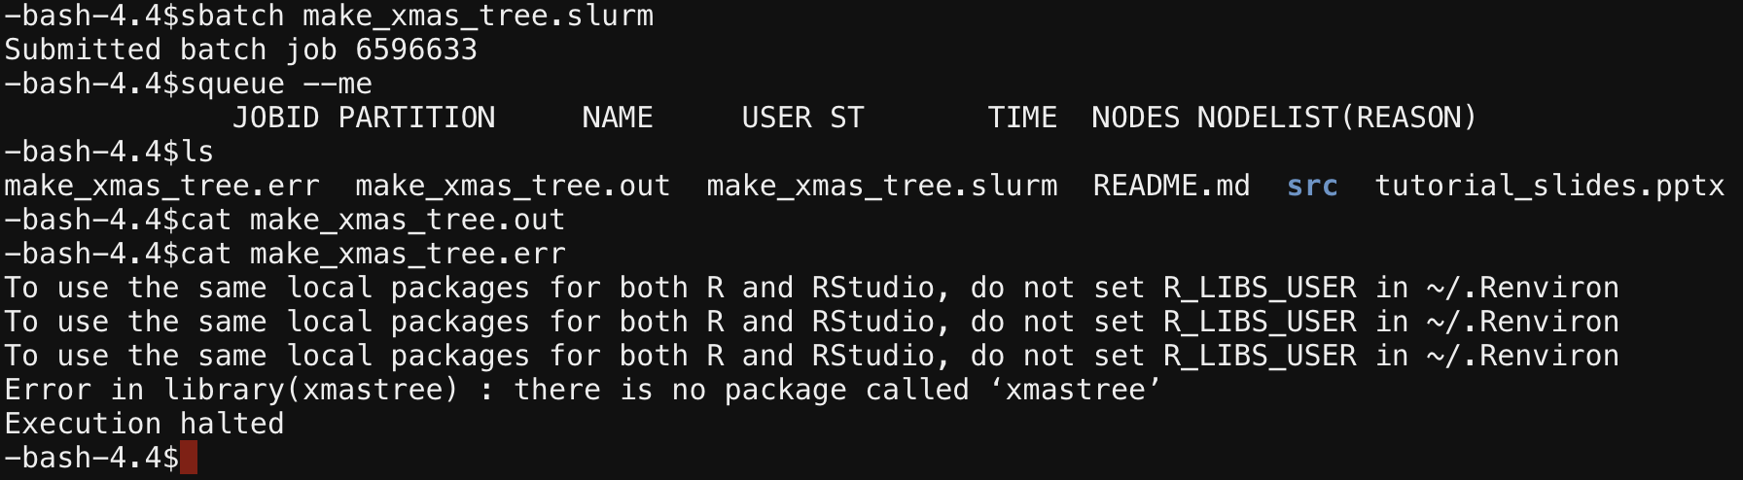
Submit the job (but it goes wrong)
Submit the job using the sbatch command with the slurm file
Check status of job using squeue; job is not listed!
List files, output image is not there!
Read slurm output file; empty!
Read error file; MISSING R PACKAGE!

Slide 40
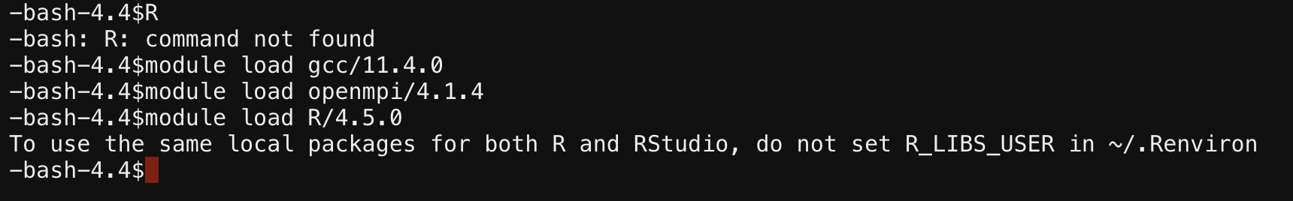
Load R
Load the modules just like they were listed in the slurm file
(otherwise, R will not open)

Slide 41
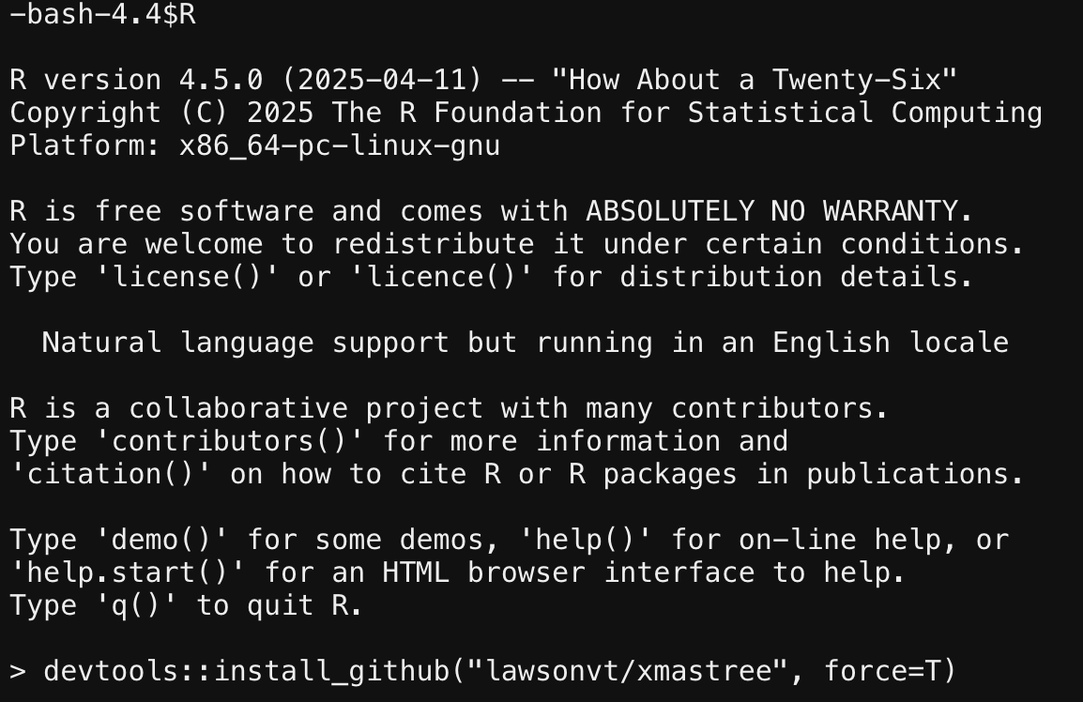
Install the missing R Package
Find the installation command from the repository:
https://github.com/lawsonvt/xmastree
Note: you may also need to install the R packages “devtools” and “ggplot2”

Slide 42
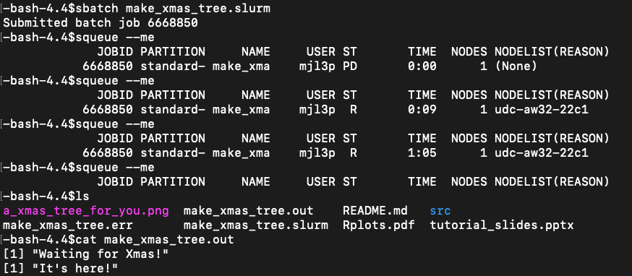
Submit the job again (success this time!)
Submit the job using the sbatch command with the slurm file
Check status of job using squeue; job is Pending!
Check status of job using squeue; job is Running!
Check status of job using squeue; job is done!
List files; see that output image has been created!
Check output file; output is correct!

Slide 43
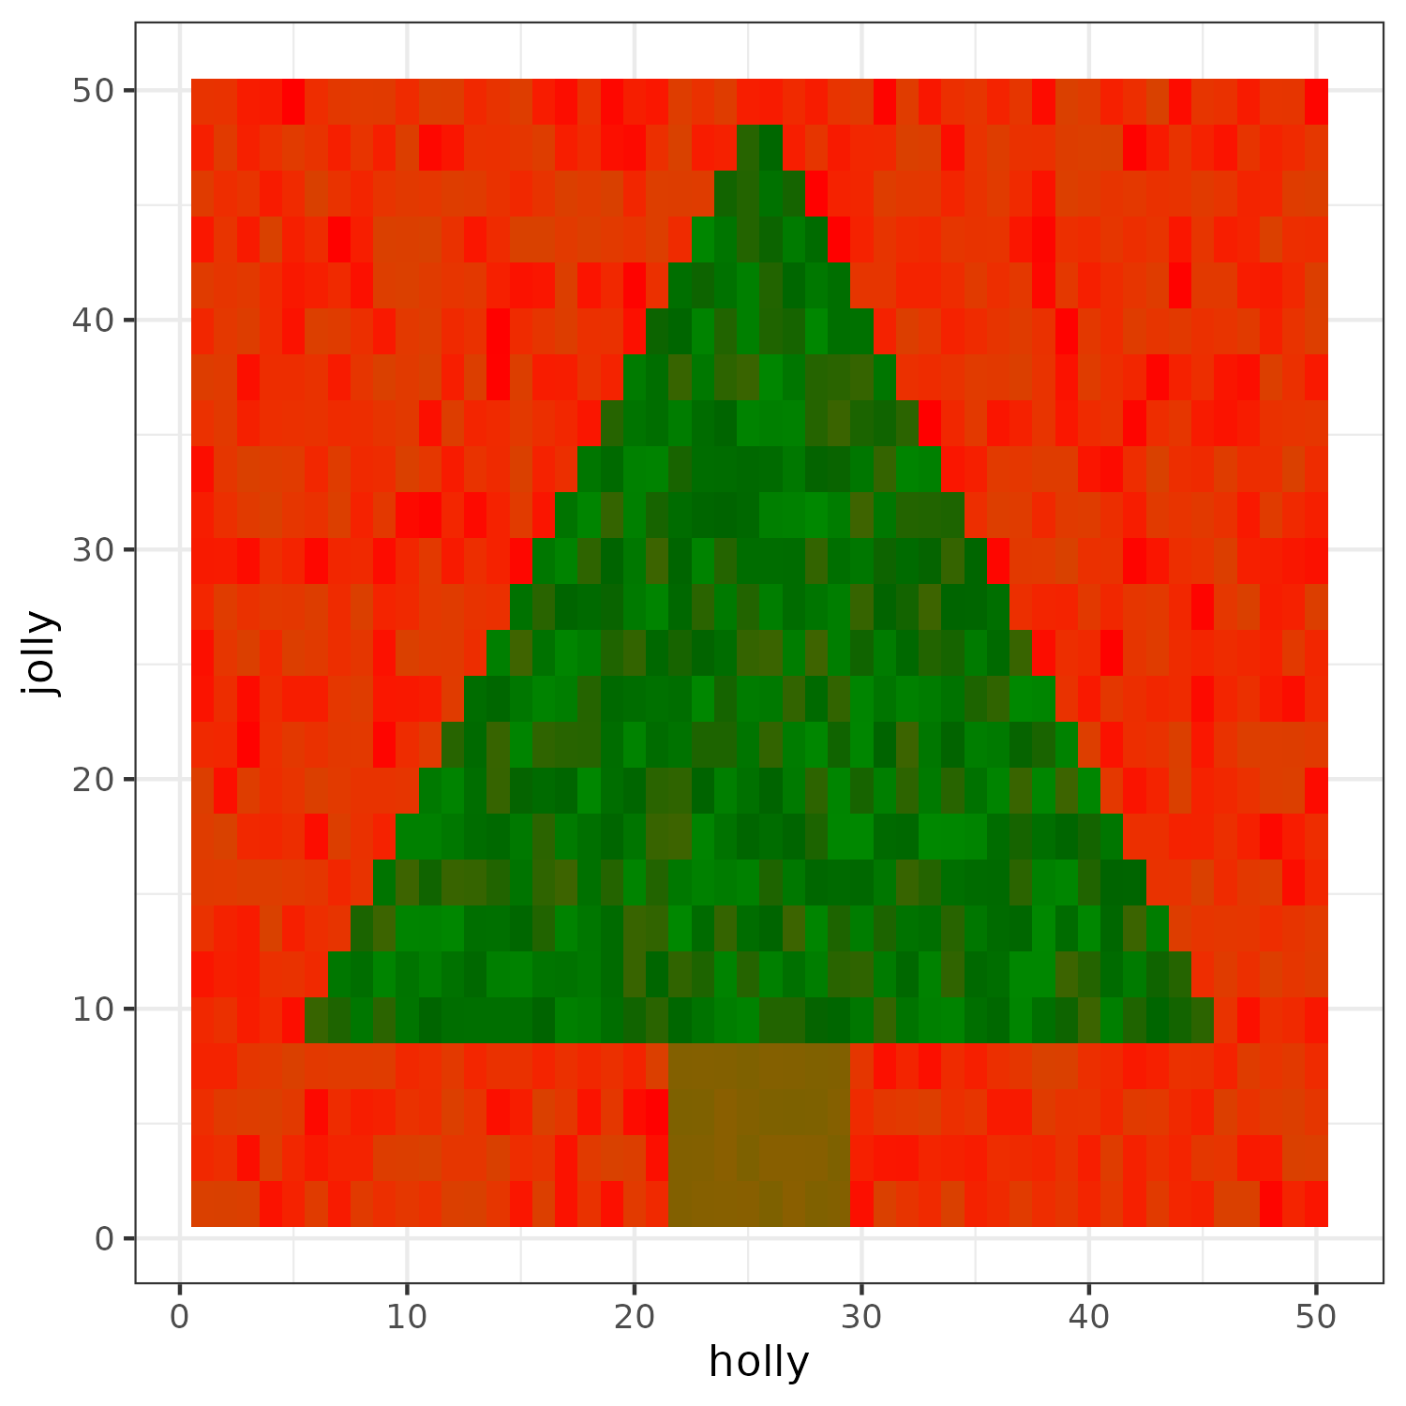
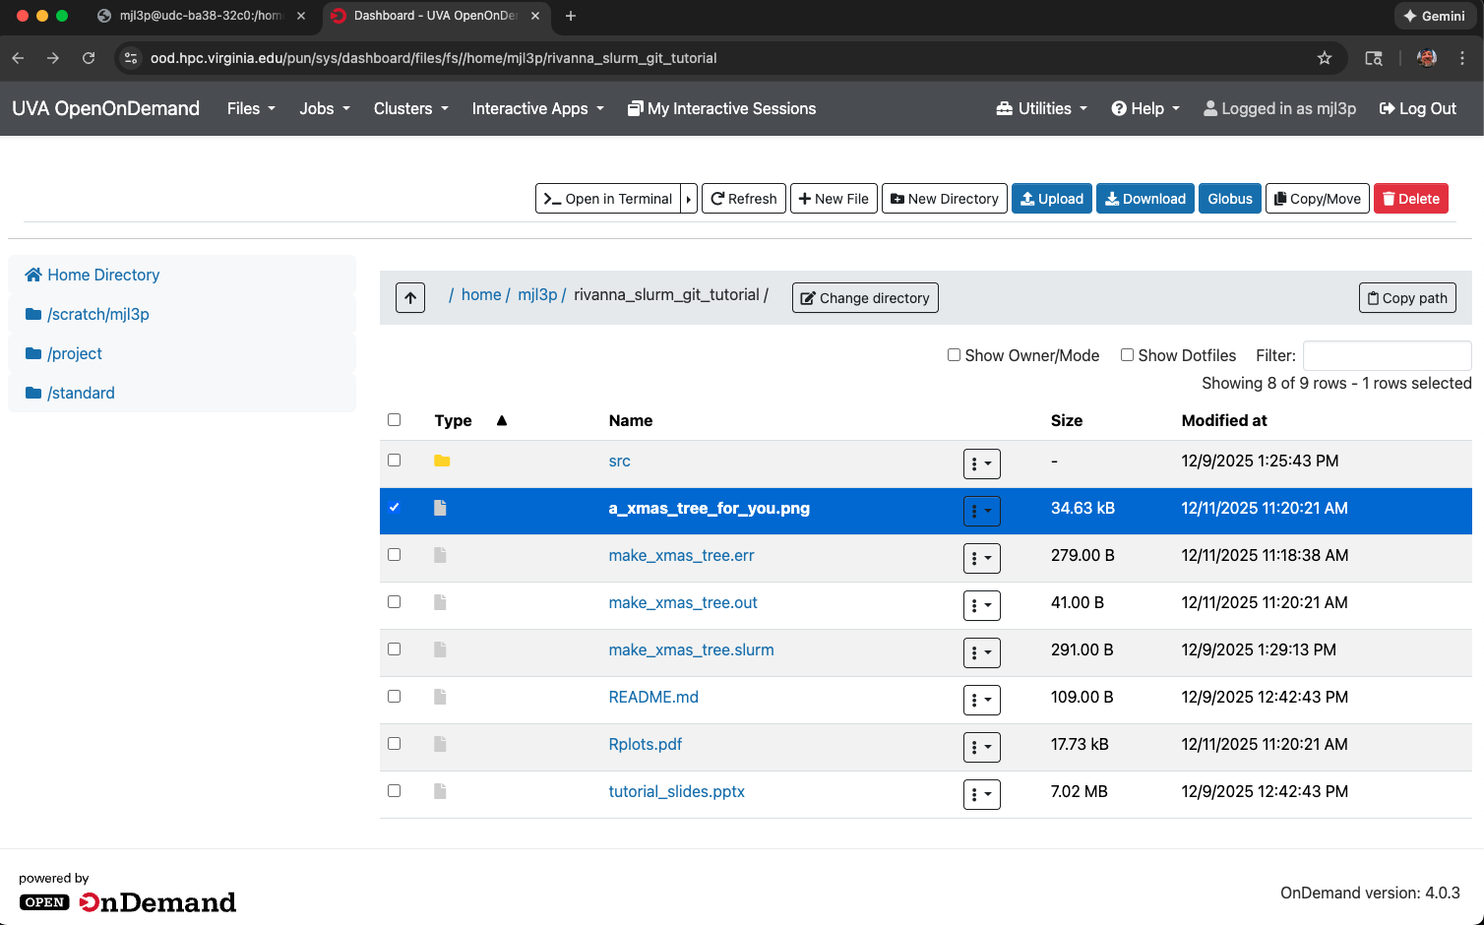
Find the tree!
Open OpenOnDemand and select the repository directory to see the results
This is also the easiest way to download your created output

Slide 44
Last Thoughts / Advice
git / Github is only powerful if you actually use it! Not committing changes and not commenting on them makes the revision tools less effective
Before submitting a big job on Rivanna, make sure to test it on a subset of the data first (maybe even on your machine). This can save many a headache of having a job run for hours only for a single line of code to be wrong
UVA Research Computing has a ticketing system for help / issues and they are very responsive and helpful
I can also help too

Slide 45
Thank you and Happy Coding!

